Slide 1
1
SPM PM REVIEW
G6T6
Zheng Yang
Maurice
Sebastian
Sujuan
Zican

Slide 2
TABLE OF CONTENTS
01
04
ROLES & RESPONSIBILITIES
FUNCTIONALITIES
02
05
PAIR PROGRAMMING
ROTATIONS
SCHEDULE
03
06
BUG METRICS
Q&A
2

Slide 3
3
FRAMEWORK
No Framework
We originally planned to use CodeIgniter but decided against it due to time constraints in learning it and actually implementing it as a team.

Slide 4
4
COMPLETED
FUNCTIONALITIES
Login
Bootstrap
Add Bid

Slide 5
5
Additional Functionalities
Display Class timetable
Overall Bid Result Statistics
Course Catalogue
Notes:
filter options for students
Bid result statistic = min, average, max like in BOSS
Course catalogue: Display all courses with filter options by school.

Slide 6
6
CLOUD DEPLOYMENT
IP address: 54.86.180.118/app
Admin Password: adminbios

Slide 7
7
SCHEDULE
Iteration 1 Planning, Login, Bootstrap & Round 1 Bid
Iteration 3 Round Controls, Round 2 Bid & Resolution, JSON Web Token & Round Controls
Iteration 5 Extra Features & Final Debugging
Iteration 2 Drop Bids, Round 1 Resolution , AWS Deployment
Iteration 4 Complete all JSON Web Service
Iteration 6 Final Presentation

Slide 8





8
Iteration 1(Completed) Week 4 & 5 9/9/2019-9/22/2019
Planning
Bootstrap
Round 1 Bidding
Testing and Debugging
Creating DAO and Objects
For Web UI Excludes JSON Bootstrap
without input validation
Login

Slide 9





9
Iteration 2 (In-Progress) Week 6 & 7 9/23/2019 - 10/06/2019
Drop Bids & Section
Round 1 Resolution
Milestone #1
AWS Deployment
Testing and Debugging
Round 1 Clearing Logic
Week 7 PM Review
Bootstrap Add Bid
Drop Bid/Section
Round 1 Clearing Logic
Notes:
Need to change this

Slide 10


10
Iteration 3 Week 8 & 9 10/07/2019 - 10/20/2019
Round 2 Bidding
Round 2 Clearing Logic
Testing and Debugging
JSON Web Token
Web UI & JSON Round Controls
Milestone #2
Add Bid
Real Time Bid Results
Round 2 Bidding
Round 2 Clearing Logic
Week 9 Demo

Slide 11

11
Iteration 4 Week 10 & 11 10/21/2019 - 11/03/2019
JSON Bids
Milestone #3
JSON Table Dumping
Testing and Debugging
Week 11 UAT
JSON Functions
Notes:
JSON Bids for admin

Slide 12



12
Iteration 5 Week 12 & 13 11/04/2019 - 11/17/2019
Extra Features #1
Extra Features #2
Extra Features #3
Testing and Debugging
Milestone preparation
Coding a timetable
Bidding Statistics
Course Catalogue
Extra Functions
Final Debugging
Preparation for final presentation

Slide 13
13
Iteration 6 Week 14 11/18/2019 - 11/22/2019
Final Presentation

Slide 14
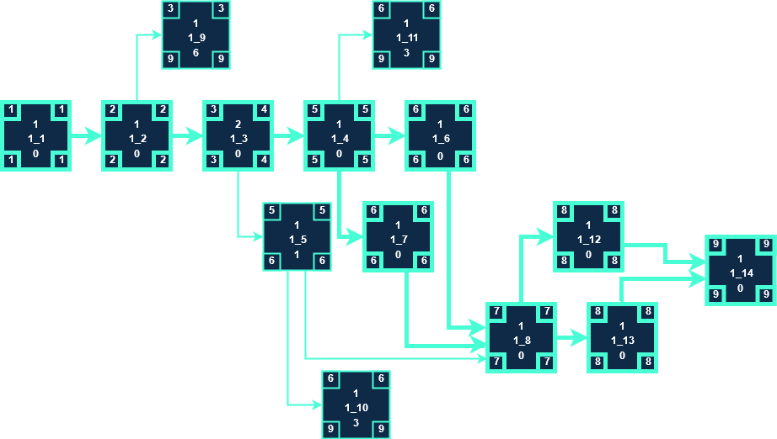
14
ITERATION 1 CRITICAL PATH
Buffer Time:
14 - 9 = 5 Days

Slide 15
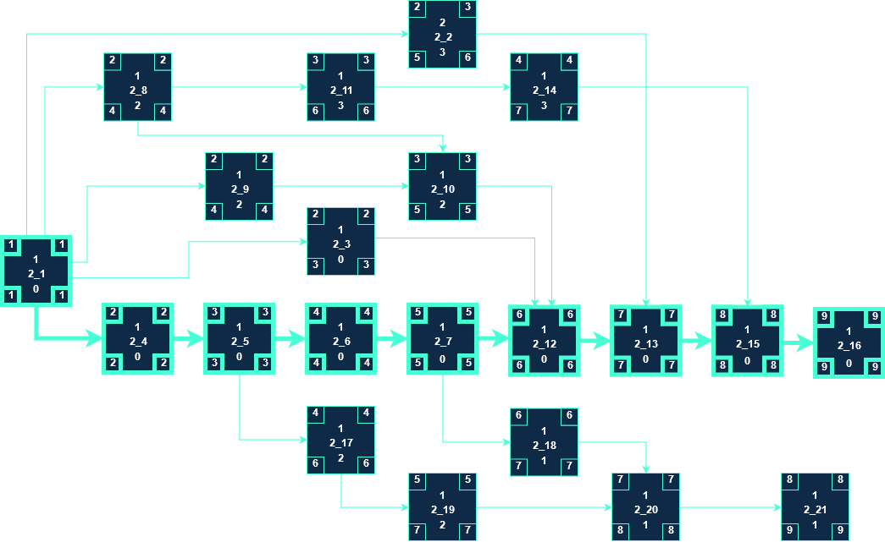
15
ITERATION 2 CRITICAL PATH
Buffer Time:
14 - 9 = 5 Days
Notes:
highlight the critical path clearly

Slide 16
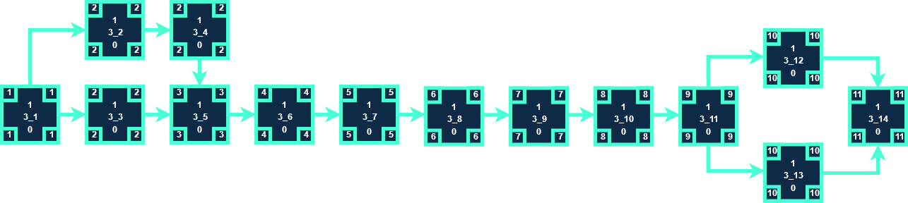
16
ITERATION 3 CRITICAL PATH
Buffer Time:
14 - 11 = 3 Days
Notes:
highlight the critical path clearly

Slide 17
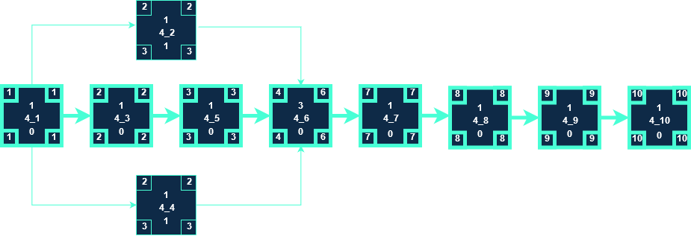
17
ITERATION 4 CRITICAL PATH
Buffer Time:
14 - 10 = 4 Days

Slide 18
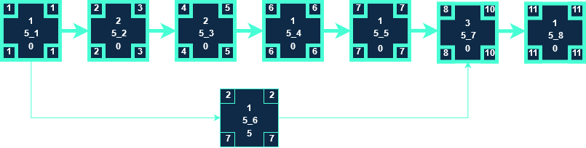
18
ITERATION 5 CRITICAL PATH
Buffer Time:
14 - 11 = 3 Days

Slide 19

19
ITERATION 6 CRITICAL PATH
Buffer Time:
5 - 4 = 1 Day

Slide 20
20
BUG METRICS
Iteration | Current Value | Total value | Mitigation | Status
1 | 0 | 8 | Use the planned debugging time in the iteration. | Resolved
2 | 5 | 30 | Stop current development and resolve the bug immediately. Project Manager reschedules the project. | Resolving

Slide 21
21
Bugs in Iteration 1(Resolved)
Functionality | Description | Severity | Points | Points Total
Login(User) | Successful login with incorrect username(case insensitive) and correct password | High | 5 | 8
Login(User) | Login page has undefined variable 'error' | Low | 1
Login(User) | Login page displayed error message "A session had already been started" | Low | 1
Bidding | Biding page displayed syntax error, unexpected '}' | Low | 1
Fixed

Slide 22
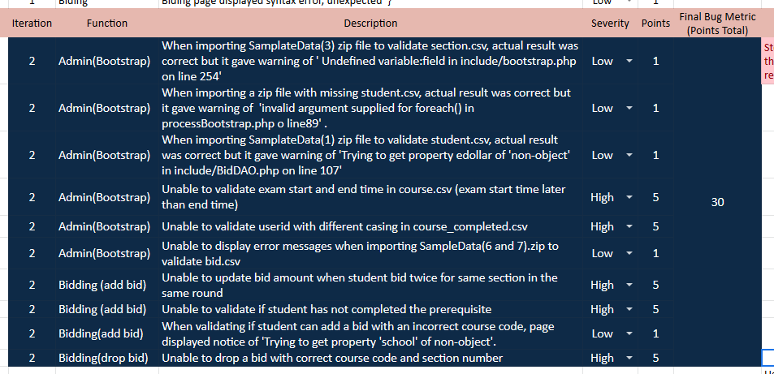
22
Bugs in Iteration 2

Slide 23
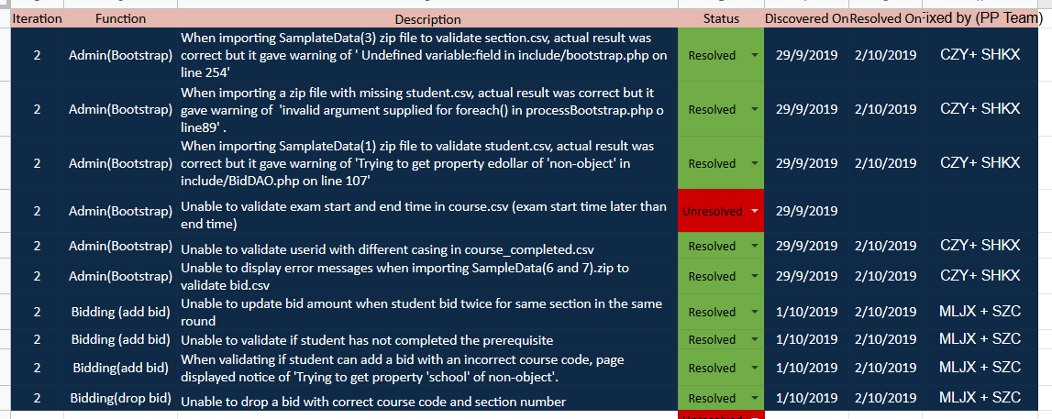
23
Bugs in Iteration 2 (Resolving)

Slide 24
24
ROLES & RESPONSIBILITIES
PM | Milestones
SuJuan | PM Review (Week 7)
ZiCan | Application Demo and Progress Update (Week 9)
Maurice | User Acceptance Test (Week 11)
Sebastian | Final reviews, debugging and push
ZhengYang | Final Presentation (Week 14)

Slide 25
25
PM & PP ROTATION
PM
PAIR 1
PAIR 2
ITER | WEEK | CZY | CSJ | SZC | MLJX | SHKX
1 | 4 - 5
2 | 6 - 7
3 | 8 - 9
4 | 10 - 11
5 | 12 - 13
6 | 14

